Slide 1
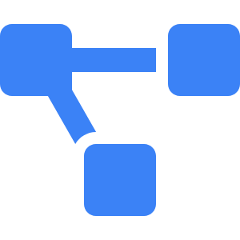


Introduction to Synapse AI
Intelligent AIOps for Microservice Reliability
Project Overview
Synapse AI embodies a state-of-the-art AIOps framework that harnesses advanced machine learning techniques to proactively detect and resolve microservice disruptions, thereby significantly reducing Mean Time To Resolution (MTTR) and enhancing overall system reliability.
Tagline
The phrase 'Intelligent, semi-autonomous AIOps solution for Google Kubernetes Engine' encapsulates our vision of merging sophisticated automation with strategic human oversight to bolster system resilience and operational efficiency.
Team Introduction
Our committed team, consisting of Abhijit Talluri, Pujith Anne, Raghavendra Chilukuri, and Bhagavan Pendiayala, is focused on pioneering advancements in the reliability and operational effectiveness of cloud-native ecosystems through innovative AI-driven solutions.
Notes:
Welcome to our presentation on Synapse AI. This initiative tackles a pressing issue in contemporary cloud-native architectures—minimizing the time required to address microservice failures. Our tagline, 'Intelligent, semi-autonomous AIOps solution for Google Kubernetes Engine,' signifies our ambition to blend automation with human insight. The dedicated team behind this project, including Abhijit Talluri, Pujith Anne, Raghavendra Chilukuri, and Bhagavan Pendiayala, is passionate about enhancing reliability and alleviating operational burdens through the innovative application of AI and Kubernetes.

Slide 2
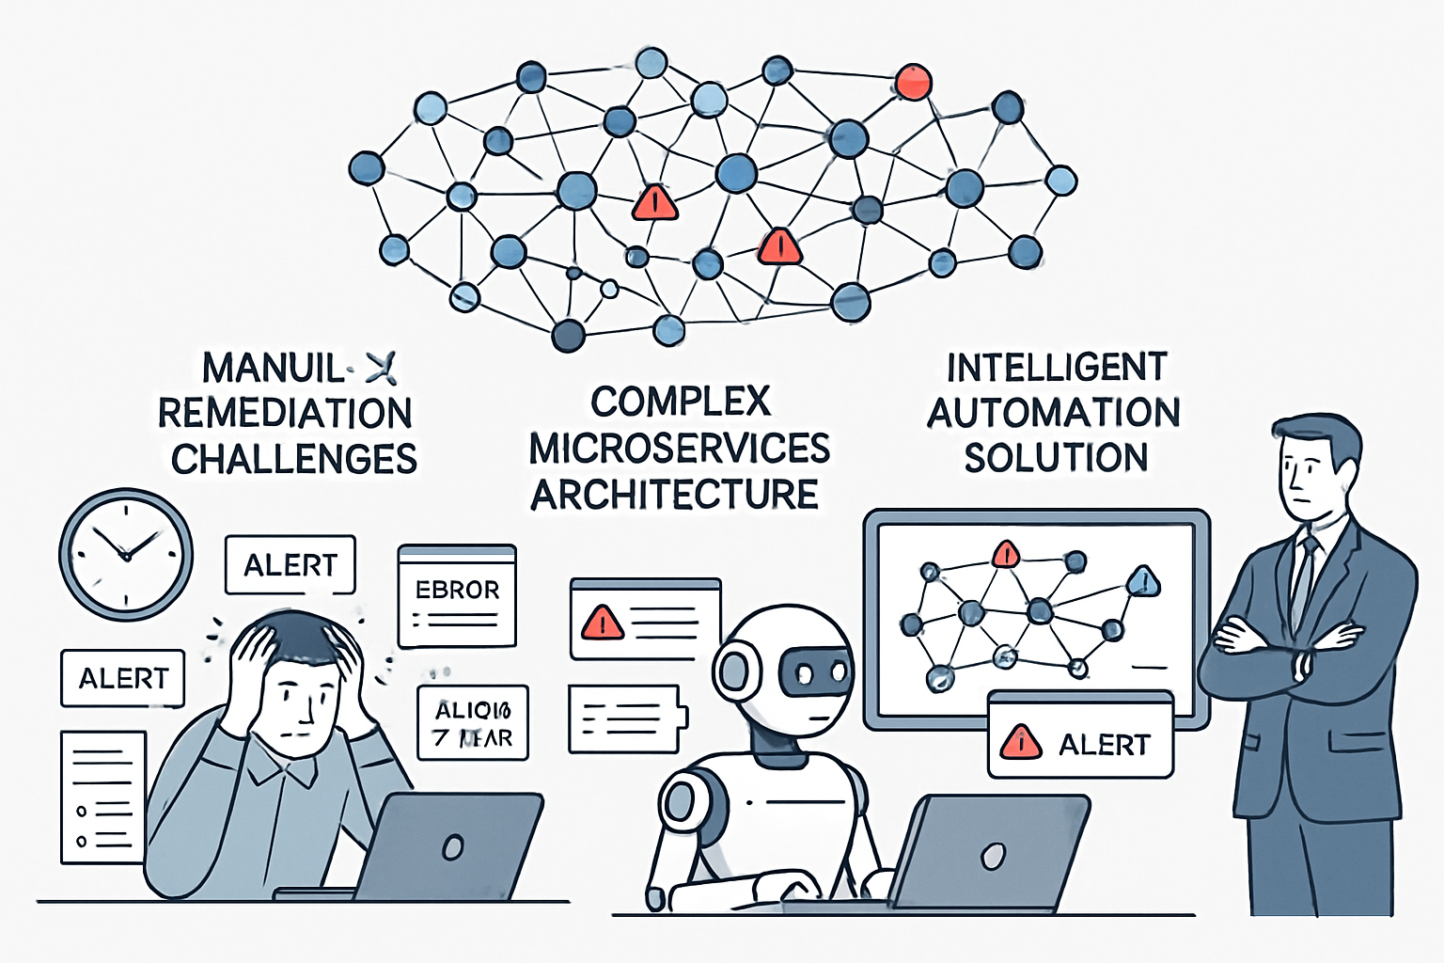
Problem Statement
Challenges in Microservice Reliability
Complexity of Microservices: Microservice architectures introduce intricate dependencies and distributed tracing challenges, making failure detection difficult.
Manual Remediation Limitations: Human-led remediation is slow, error-prone, and repetitive, consuming valuable developer time.
Need for Intelligent Automation: An automated system with human oversight is essential to reduce MTTR and improve operational efficiency.
Notes:
Modern microservice architectures, while powerful, are inherently complex. Failures can ripple across services, and identifying the root cause often requires deep analysis of logs, metrics, and traces. Manual remediation is not only slow but also distracts developers from innovation. This slide emphasizes the urgent need for intelligent automation that can accelerate recovery while maintaining human control.

Slide 3
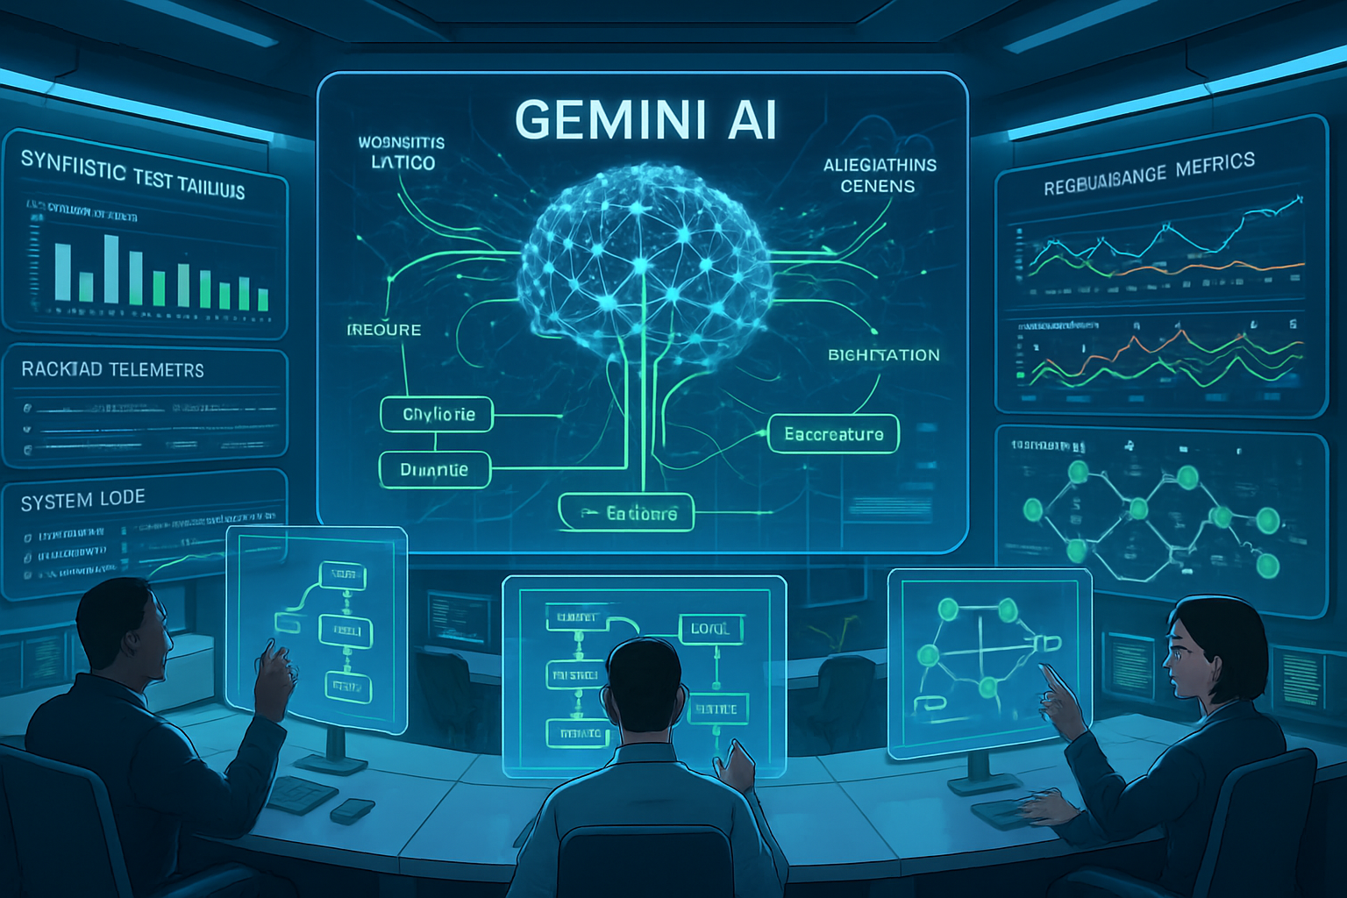
Solution Overview
Synapse AI Auto-Heal Architecture & Automation
AI-Driven Remediation: Synapse AI Auto-Heal leverages advanced algorithms to correlate synthetic test failures with backend telemetry, initiating sophisticated remediation workflows that adapt to the context of the failure.
Human-in-the-Loop Safety: The system incorporates structured approval workflows that require human oversight for automated actions, ensuring that operational integrity and user trust are preserved throughout the remediation process.
Gemini-Powered Analysis: Utilizing Gemini AI models, the system conducts comprehensive analyses of logs, metrics, and traces, enabling it to pinpoint root causes of failures and suggest targeted corrective measures with high accuracy.
Notes:
Synapse AI Auto-Heal is engineered to seamlessly connect failure detection with resolution strategies. By merging synthetic testing with backend telemetry, it can autonomously recommend remediation actions tailored to specific incidents. Nevertheless, the importance of safety cannot be overstated; the inclusion of human-in-the-loop workflows guarantees that all automated interventions are thoroughly reviewed. Central to this intelligent framework are the Gemini AI models, which deliver profound insights into system dynamics and failure trends.

Slide 4
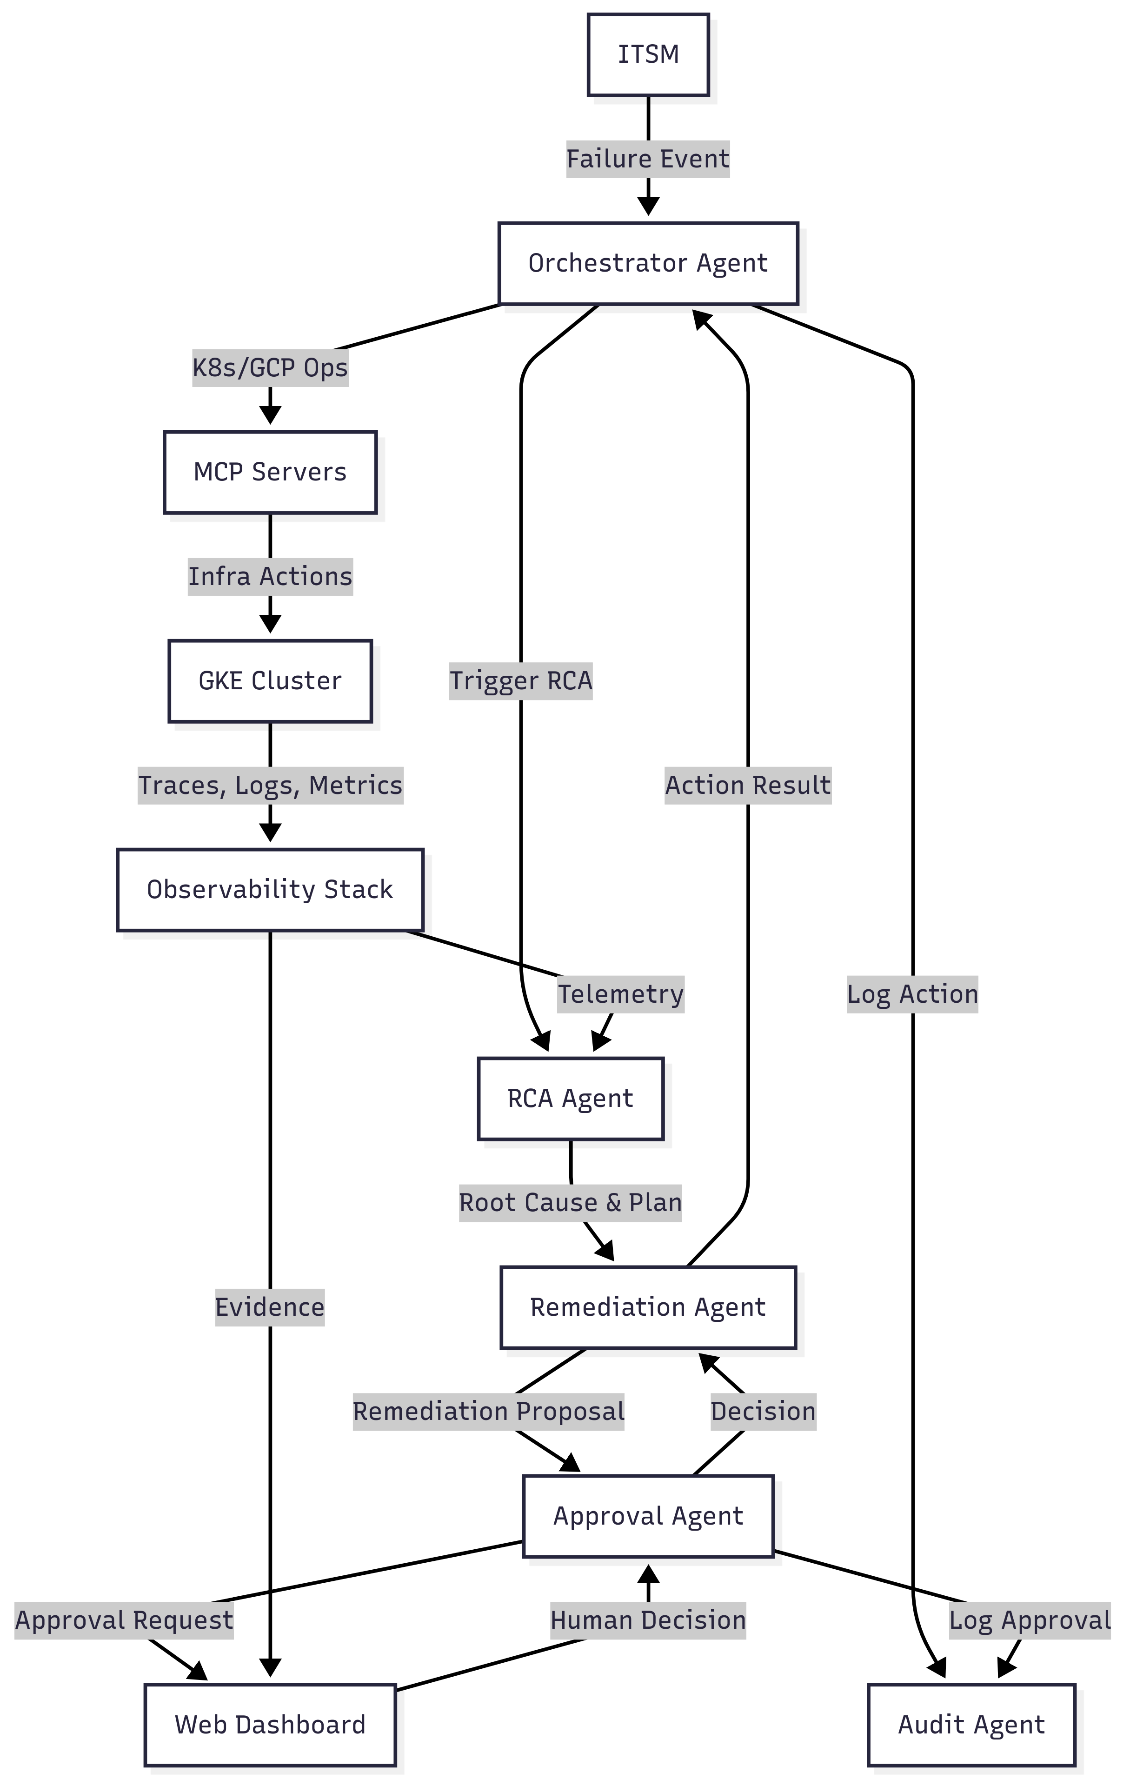
Architecture Highlights
Multi-Agent System for Auto-Healing
Failure Detection: Playwright tests with custom reporters identify user-facing failures in real-time, triggering the healing workflow.
Specialized Agents: Orchestrator, RCA, Remediation, Approval, and Audit agents work together to analyze, act, and document the healing process.
MCP Server Integration: MCP servers facilitate secure and reliable communication between agents and system components.
Notes:
The architecture of GKE Auto-Heal is built around a robust multi-agent system. Each agent plays a specialized role—from detecting failures to coordinating remediation and ensuring compliance. Playwright tests act as the first line of defense, identifying issues that impact user experience. Once triggered, the orchestrator coordinates the flow, while RCA and remediation agents use AI to diagnose and fix problems. Approval and audit agents ensure transparency and control. MCP servers serve as the backbone for secure inter-agent communication.

Slide 5



Key Technical Features
Intelligent RCA, Secure Automation, and Compliance
Distributed Trace Correlation
End-to-end tracing from frontend to backend enables precise identification of failure points across services.
LLM-Powered RCA
Gemini AI models analyze logs, metrics, and traces to perform intelligent root cause analysis.
Secure & Auditable Automation
Human-friendly dashboards, approval workflows, and audit trails ensure safe and compliant remediation.
Notes:
This slide highlights the technical backbone of GKE Auto-Heal. Distributed trace correlation allows the system to follow the journey of a request across services, pinpointing where things go wrong. Gemini-powered RCA brings AI into the mix, analyzing telemetry data to uncover root causes. And to ensure trust and compliance, every action is logged, visualized, and approved through secure workflows and dashboards.

Slide 6



Demo Preview
Simulated Failure and Auto-Healing Flow
Failure Simulation
A payment service failure in Online Boutique is triggered to demonstrate the auto-healing process.
Detection & RCA
Playwright tests detect the issue, and Gemini-powered RCA identifies the root cause using telemetry data.
Remediation Workflow
The system proposes a fix, routes it through the approval interface, and executes automated remediation.
Notes:
In this demo, we simulate a failure in the payment service of Online Boutique to showcase GKE Auto-Heal in action. The system detects the issue using Playwright tests and initiates root cause analysis through Gemini AI. Once the problem is identified, a remediation plan is proposed and routed through a human approval interface. Upon approval, the system executes the fix and verifies recovery, demonstrating the full auto-healing lifecycle.

Slide 7



Conclusion & Future Work
Transforming Microservice Reliability
Key Benefits
GKE Auto-Heal reduces MTTR, minimizes operational toil, and enhances system reliability through intelligent automation.
Future Enhancements
Plans include predictive failure detection and self-learning remediation strategies to further improve resilience.
Call to Action
"Let's transform how we manage microservice reliability"—join us in building smarter, safer cloud-native systems.
Notes:
To wrap up, GKE Auto-Heal offers a powerful step forward in managing microservice reliability. By combining AI-driven insights with human oversight, it significantly reduces downtime and operational burden. Looking ahead, we aim to make the system even smarter with predictive capabilities and adaptive learning. We invite you to be part of this transformation—let’s redefine how we heal and manage cloud-native systems.

